Slide 1
Air Pollution in Ethiopia
Examining exposure and associated burden of disease

Slide 2
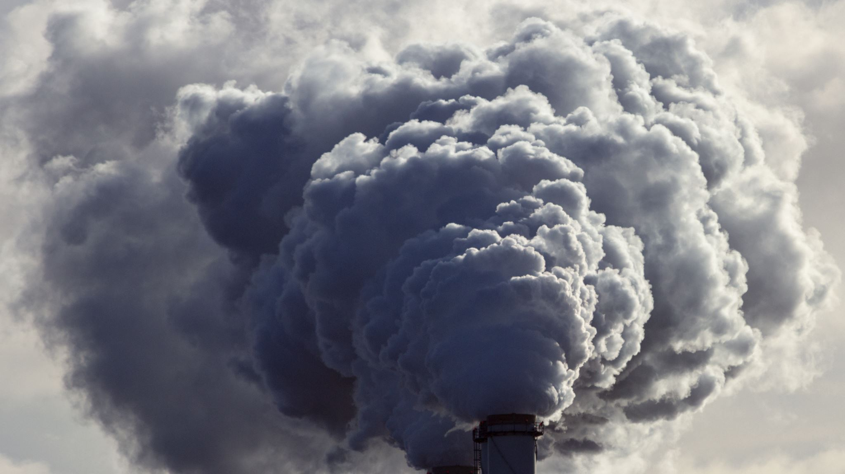
Introduction
Air pollution is a major global health issue, especially in low and middle income countries, accounting for 6.7 million deaths worldwide in 2019 alone_{1.}
Sources of air pollution both in and outside of households are varied and tricky to tackle, often requiring data-informed policies implemented at all levels of government.
This project aims to analyze the air pollution exposure and associated burden of disease in Ethiopia to potentially offer such data-driven policy and investment directions for the developing nation.
The data used was obtained from various publicly available datasets, mostly those published by international bodies and organizations.
Source: 1) World Health Organization.

Slide 3
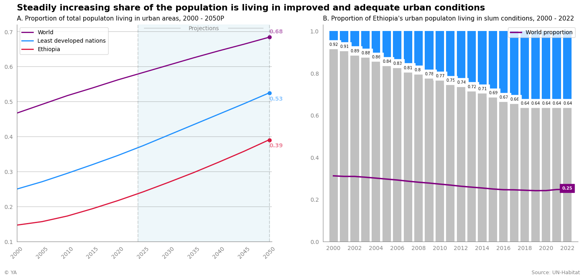
Ethiopia’s demographic
Population nearly quadrupled in four decades, reaching 126.5 million in 2023
Far outpacing global growth but slowing
Explosive growth driven by high fertility rate and lowering mortality rate
Nation is slowly urbanizing but still in early stages of development
31 million people living in urban areas
20 million of whom are in slum-like conditions

Slide 4
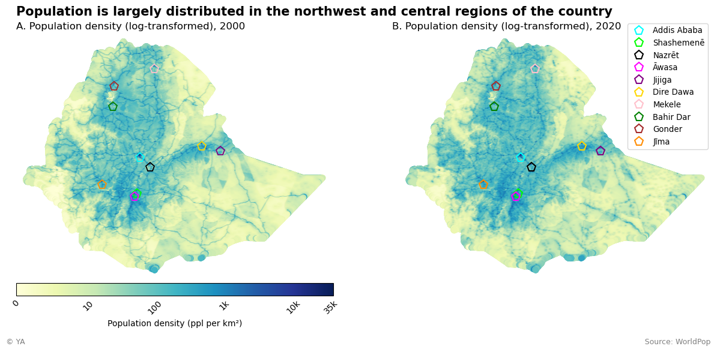
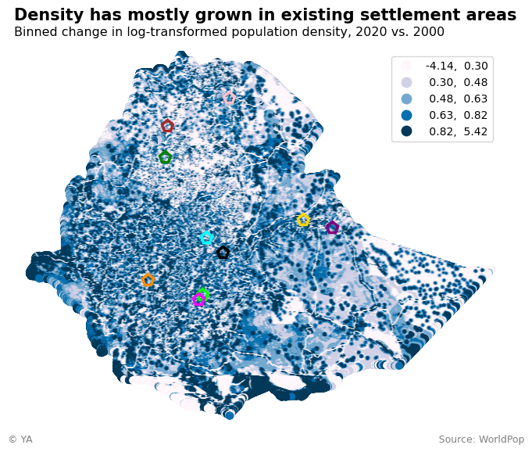
Population settlements
Most of the population can be found in the northwest and central areas, where historically the most arable land has been located₁
Densest zones are major cities, with some locations in the capital, Addis Ababa, exceeding 30 thousand ppl per km²
The peripheral regions are sparsely populated due to non-arable land and/or harsh conditions₂
People have generally settled in already established areas in the last two decades or so
Many of the major cities experienced density growth, highlighting the on-going urbanization trend
Source: 1 & 2) Britannica.

Slide 5
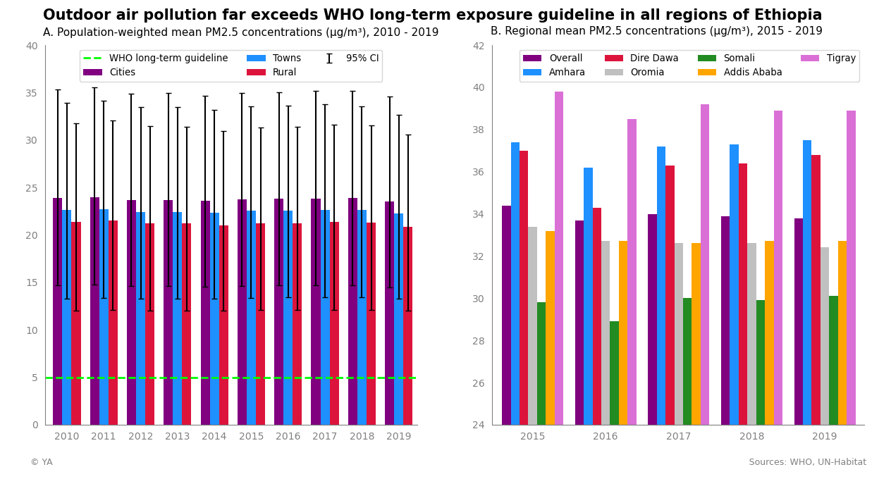
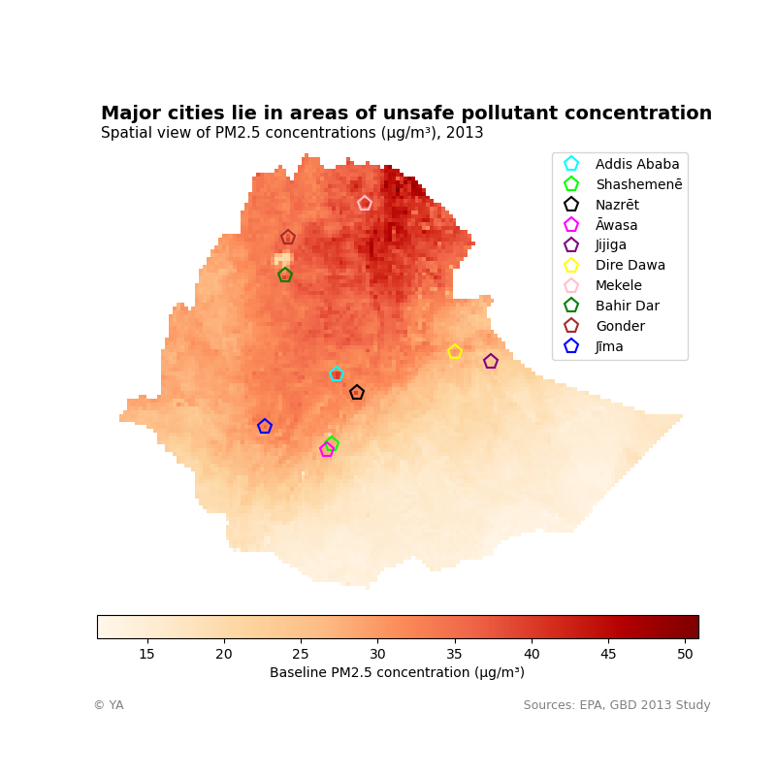
Ambient Air Pollution exposure
Wide-spread exposure to unsafe levels of ambient PM2.5 (fine particulate matter), 3 – 8x times WHO long-term exposure guideline
Cities on average seem to have the worst exposure relative to towns and rural areas
Concentration levels remained steady over the scope of data
The worst ambient air quality is in the northeast region of Afar due to its common volcanic activity and desert storms₁
Air pollution levels map closely with population settlement
Localized spikes in concentration at center of some cities (e.g., Addis Ababa, Nazrēt, Bahir Dar, Gonder)
Source: 1) Britannica.

Slide 6
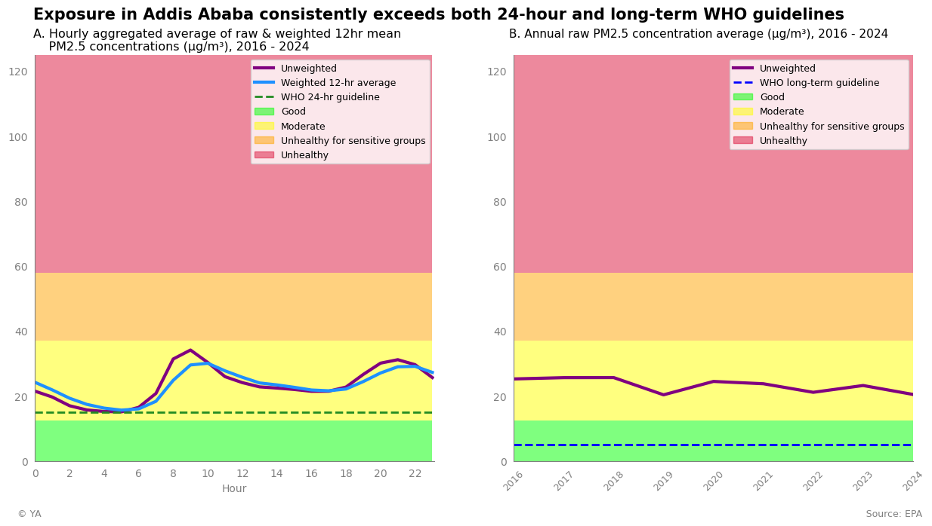
ADDIS ABABA OUTDOOR Air Quality
PM2.5 levels are highest between 8 – 10 AM and 7 – 9 PM with averages exceeding 30 µg/m³
These are common commute times, highlighting vehicle emissions impact
Average concentration over the course of a day consistently exceeds the WHO 24-hour guideline of 15 µg/m³, affecting Addis Ababa’s 5.7 million residents₁
Like regional trends, concentration levels in the city have remained mostly flat over the 8 years, albeit at unsafe levels
Source: 1) World Population Review.

Slide 7
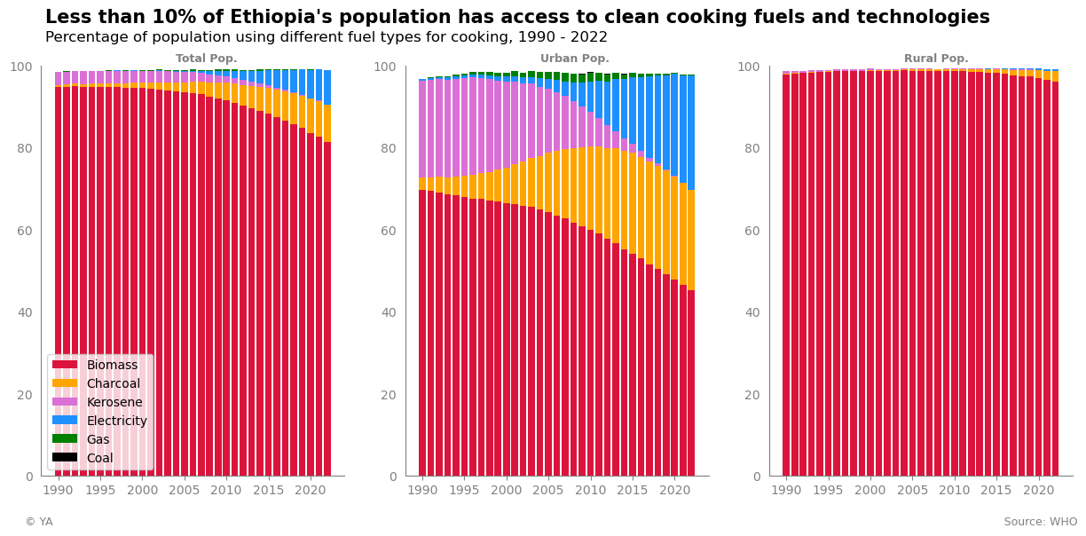
Household Air Pollution Exposure
Overwhelming majority of the total population still relies on polluting fuels for cooking
Only 8.5 % of population has access to clean cooking fuels and tech. as of 2022
13.5 pp. decline in biomass use in three decades
The growing access to safer alternatives is slow and limited to urban areas
27.6 pp. net gain in urban clean cooking fuel access over 30-year period
21.4 million people in urban areas still relying on unclean fuels
Over 95 % of rural population primarily cooks with biomass

Slide 8
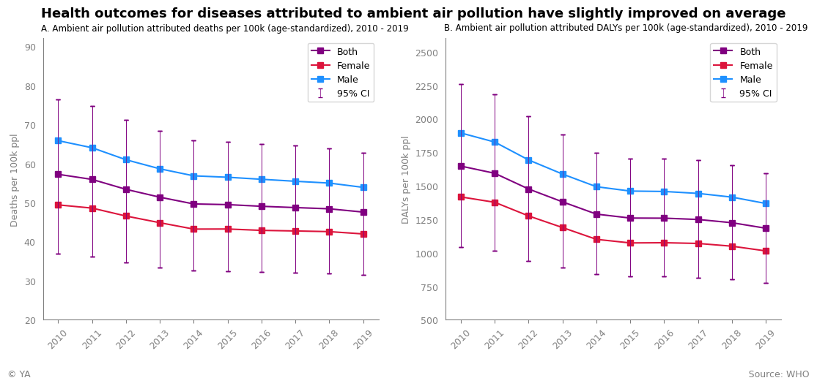
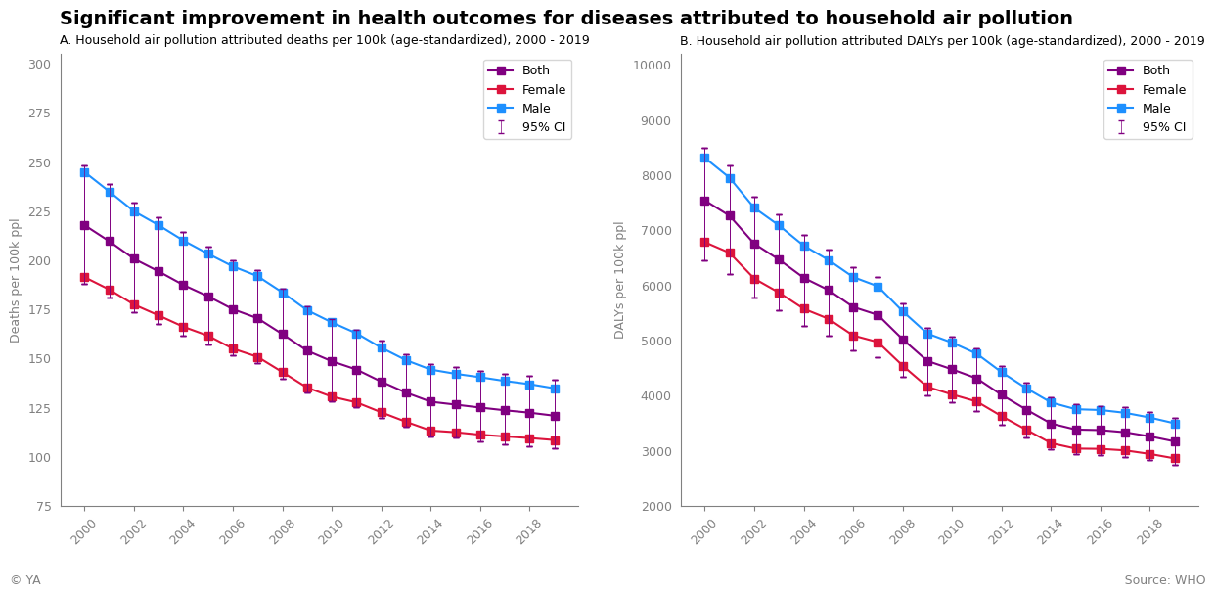
Air Pollution Associated Burden of Disease
Only slight improvement for health outcomes related to ambient air pollution -- potentially explained by the flat trend in outdoor air quality
Burden of disease, on average, seems higher for men
Ethiopia does slightly better than the world averages with respect to mortality and DALYs rates₁
Household air pollution is much more of a public health issue in the country
Large strides in expanding healthcare and clean fuel access in urban areas explain much of the significant improvements in outcomes
Despite this progress, mortality and DALYs rates were more than double the world averages in 2019₂
Source: 1 & 2) World Health Organization.

Slide 9
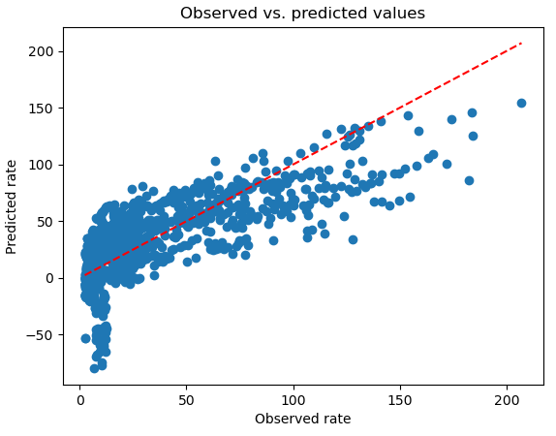
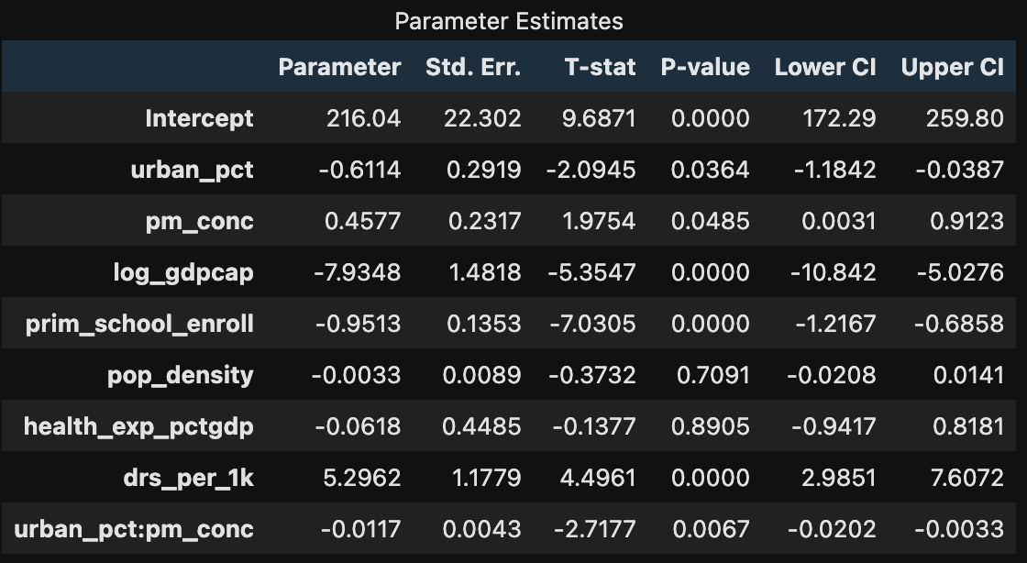
Fixed effects model – Predicting under-5 mortality rate
See Appendix for short description of variables
Estimator: Fixed effects with entity and time effects (PanelOLS)
Cov. Estimator: Clustered
Overall R²: 0.52
No. Observations: 1405
No. Entities: 164
Time periods: 20
The model achieves statistical significance (F-statistic robust p-value < 0.001)
Every 1 percentage point (pp) increase in urbanization is significantly associated with a decrease of 0.61 deaths per 1000 live births in under-5 mortality rate
Every 1 µg/m³ increase in mean ambient PM2.5 concentration is significantly associated with an increase of 0.46 deaths per 1000 live births in under-5 mortality rate
Every pp increase in urbanization above 0% is significantly associated with an additional mitigatory decrease of 0.01 deaths per 1000 live births in under-5 mortality rate related to mean ambient PM2.5 concentration

Slide 10



Potential Policy and investment Directions
Identified Problem: Low urbanization rate and high urban slum rate
Guidance:
Effective urbanization offers many benefits to the wellbeing and development of a nation₁
Urbanization movements are historically successful when₂:
Gov’t expands affordable housing and public infrastructure access
All stakeholders have agency in directing policy and public fund allocation decision-making
Identified Problem: Unsafe outdoor PM2.5 levels exasperated by vehicle emissions that will likely grow with urbanization
Guidance:
Vehicle penetration in Ethiopia was less than 10 per 1000 as of 2019, but these vehicles are mostly very aged imports₃
High import taxes and zero age / fuel regulation incentivizes purchase of older, cheaper, fuel inefficient vehicles₄
Changes in import and/or motorization policy will be critical in mitigating mass import of high-polluting vehicles
Identified Problem: High household air pollution exposure from limited clean cooking fuel access
Guidance:
Long-term investments in infrastructure and clean energy production to expand electricity access
Short-term investments in innovative, risk-mitigating technologies like improved biomass cookstoves which have been demonstrated to half household PM2.5 levels₅
Sources: 1 & 2) United Nations Department of Economic and Social Affairs, 3 & 4) Gorham, R. et al. (2017). Motorization Management in Ethiopia, World Bank, 5) United Nations Development Program.

Slide 11
Appendix - Regression variables
Dependent variable: under-5 mortality rate (under 5 years of age deaths per 1000 live births)
Predictor 1: pct of population in urban areas
Predictor 2 : mean ambient PM2.5 concentration in µg/m³
Control 1: log GDP per capita (current US$)
Control 2: pct of primary-school-aged children enrolled in school
Control 3: population density per km²
Control 4: domestic general government health expenditure as pct of GDP
Control 5: number of doctors per 1000 people
Predictor 1 x Predictor 2: interaction term between urbanization pct and PM2.5 concentration variables

